Slide 1
Patterns in Social Signatures
Matthew J. Chandler
iCeNSA, NetHealth Project
May 7, 2019

Slide 2
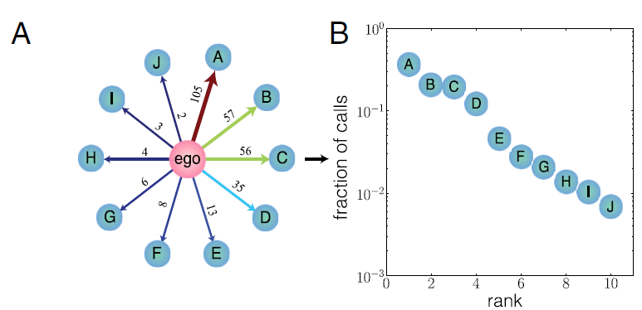
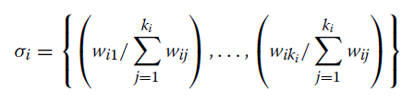
Preliminaries
Definition of “social signature”
The relative distribution of edge weights across an egocentric network
Especially, ranked proportion of interaction frequency within a given window of time
Like degree distribution for egonets
Calculation procedure
Define time window and bins for weighting
Compute weights for each ego-alter edge, as well as the total weight across edges
Rank edges by weight (descending order)
Compute the proportion of total weight for each edge as a function of its rank
Saramäki, et al. 2014. “Persistence of Social Signatures in Human Communication.” PNAS 111(3): 942-947. Fig. 1.
Heydari, et al. 2018. “Multichannel Social Signatures and Persistent Features of Ego Networks.” Applied Network Science 3(8). Eq. 1.

Slide 3
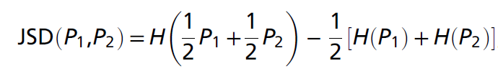
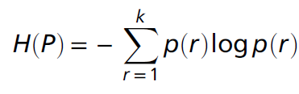
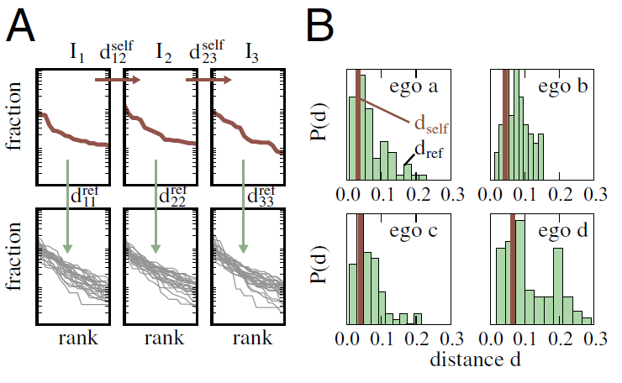
Preliminaries
Measuring similarity/difference between social signatures
The studies take an information-theoretic approach, using Jensen-Shannon Divergence (“JSD”; Lin 1991) to compare entire distributions (allowing zeros when they have unequal lengths)
Assessing stability
Self-divergence: mean JSD for social signatures for the same ego at all pairs of consecutive time windows
Reference-divergence: mean JSD for all pairs of social signatures in a window
Location tests for difference between self and reference distributions: if self mean is significantly less than reference mean, then it’s stable
Saramäki, et al. 2014. Eqs. 2-3.
Saramäki, et al. 2014. Fig 1.

Slide 4
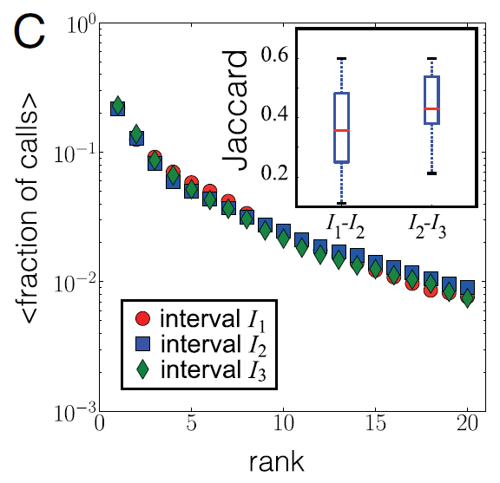
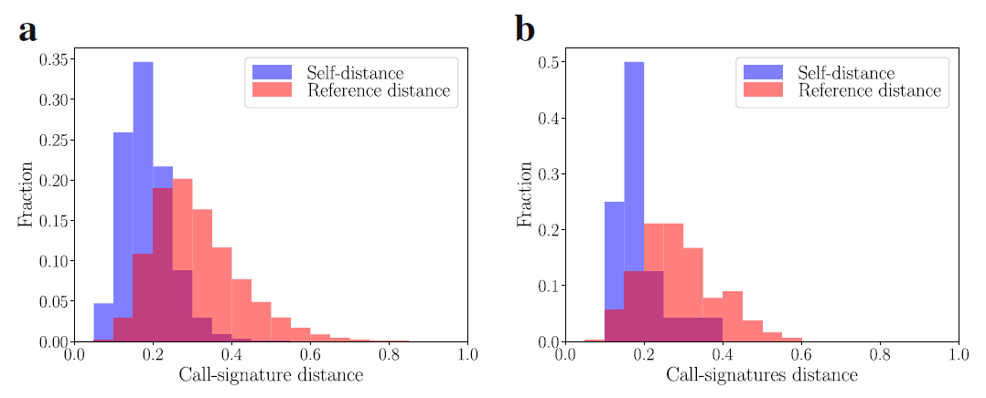
Preliminaries
Major claims so far
Social signature varies across persons, adding contour to weighted degree
Egos’ social signatures tend to be stable over time, despite alter turnover
Social signature is associated with perceived closeness
The patterns hold for multiple channels of communication (call and text)
Significance
Extension of Dunbar’s findings on humans’ cognitive-relational capacities
Some ties to the Big 5 (Centellegher, et al. 2017), but linkage to social demographics and health outcomes not yet explored
Saramäki, et al. 2014. Fig. 1.
Heydari, et al. 2018. Fig. 2.

Slide 5
Explorations with NetHealth Data
Replicate major findings
So far, just outgoing calls from iOS devices
Still need to clean up multichannel data
Still need to link to netsurvey data
The stability claim is robust
Despite turnover
Holds up to all window widths
But there is plenty more to be said about relative stability and cross-sectional divergence
Search for more patterns
Examine the divergence more broadly
Characterize the general form of social signature
Power-law models fit best
But not resoundingly better than alternatives
How long before ego’s model is stable?

Slide 6
Two Approaches to Binning for Outgoing Calls
Calendar-Based Windows
July 1, 2015 through June 30, 2017
Min 2 alters per window per ego
Min avg 10 calls per window per ego
4 Definitions
Academic Years (Jul-Jun)
Semesters (Jul-Dec; Jan-Jun)
Quarters (Jul-Sep; Oct-Dec; Jan-Mar; Apr-Jun)
Months
Week-Based Windows
July 6, 2015 through July 2, 2017
104 Monday-Sunday Weeks
Min 2 alters per window per ego
3 Definitions
3-week moving in 1-week increments
2-week discrete
1-week discrete (not enough egos)

Slide 7
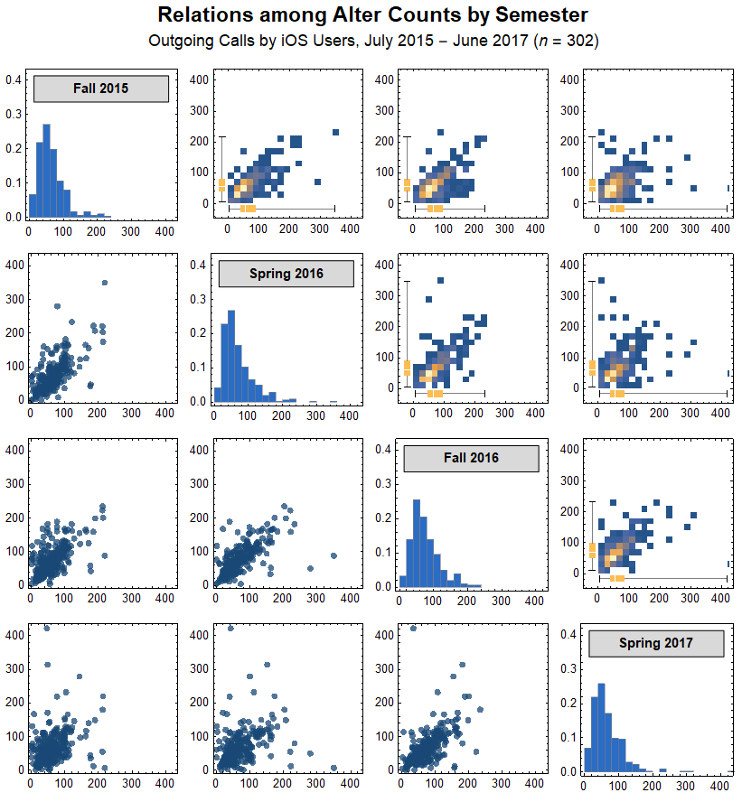
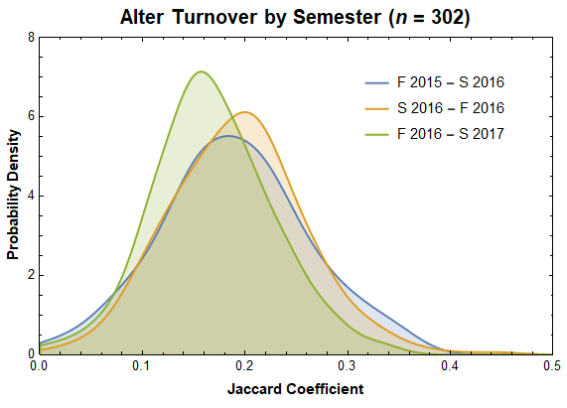
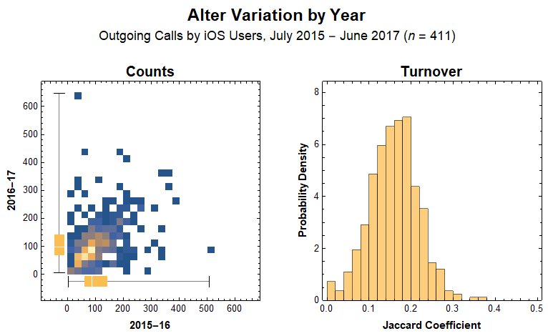

Slide 8
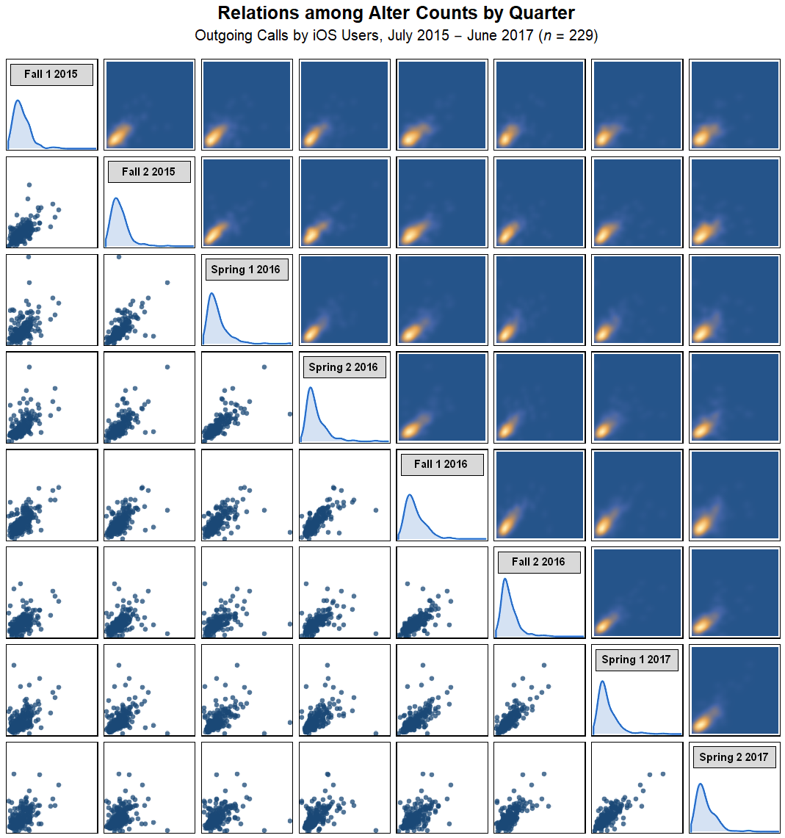
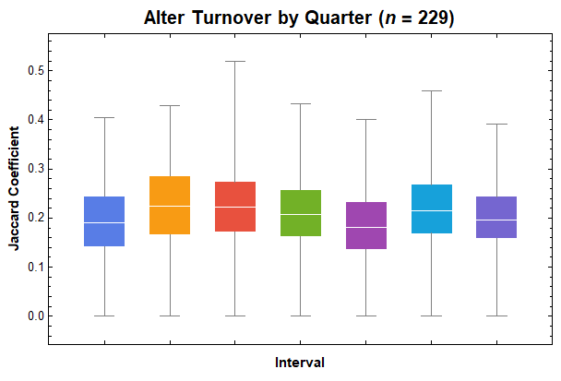
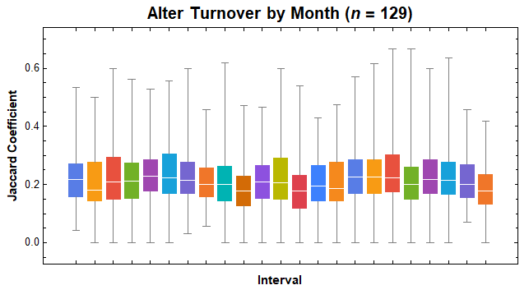

Slide 9
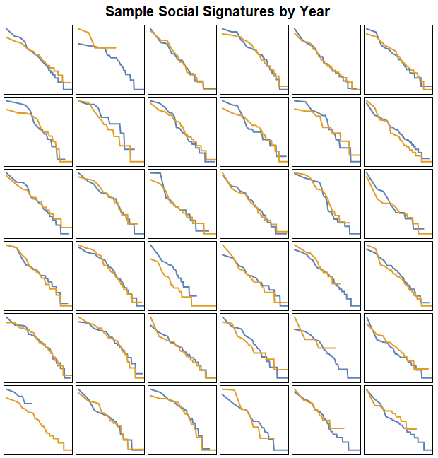
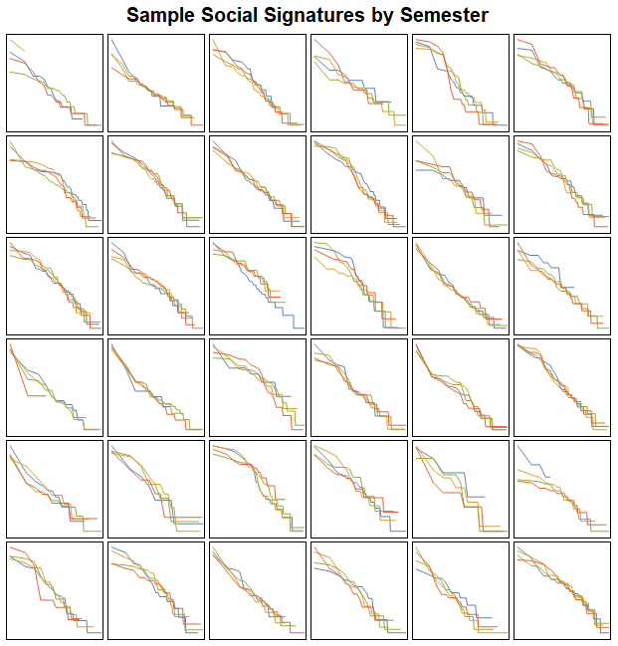

Slide 10
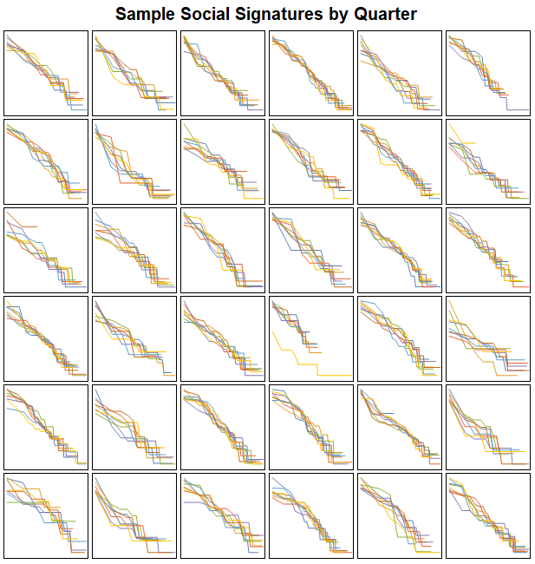
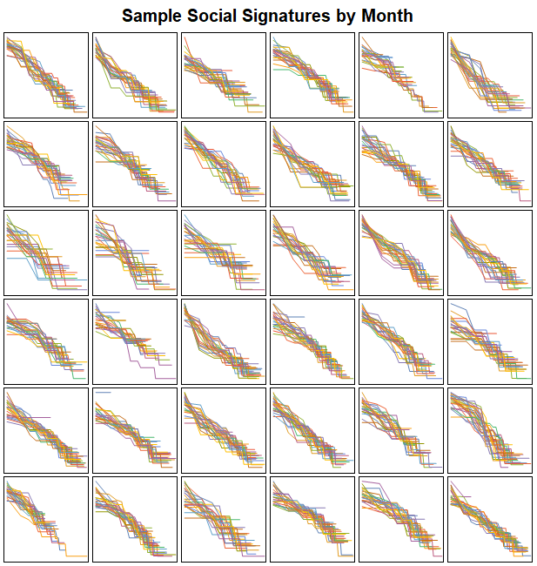

Slide 11
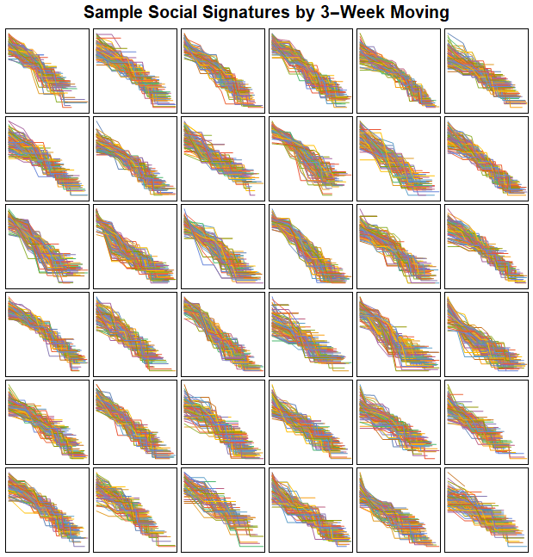
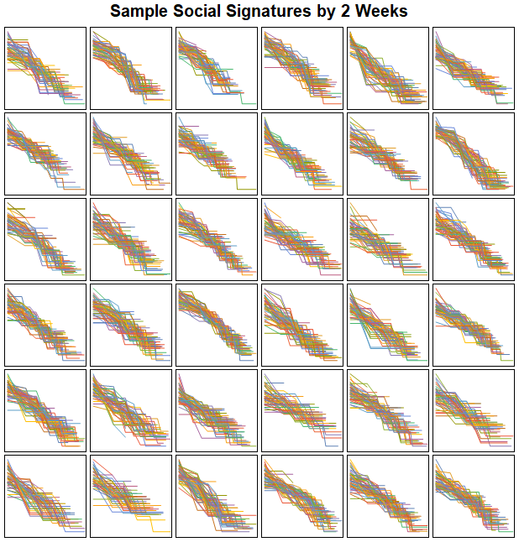

Slide 12
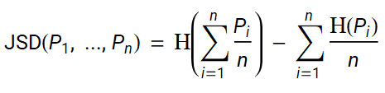
Generalized Jensen-Shannon Divergence
Symmetric, n-ary function with non-negative, finite outputs
Varying weights are allowed, but I assume equal weighting for all distributions
For distributions of differing lengths, I append zeros to the shorter distributions so all are the same length
Done on-the-fly
Lin, Jianhua. 1991. “Divergence Measures Based on the Shannon Entropy.” IEEE Transactions on Information Theory 37(1): 145-151. Eq. 5.1.

Slide 13
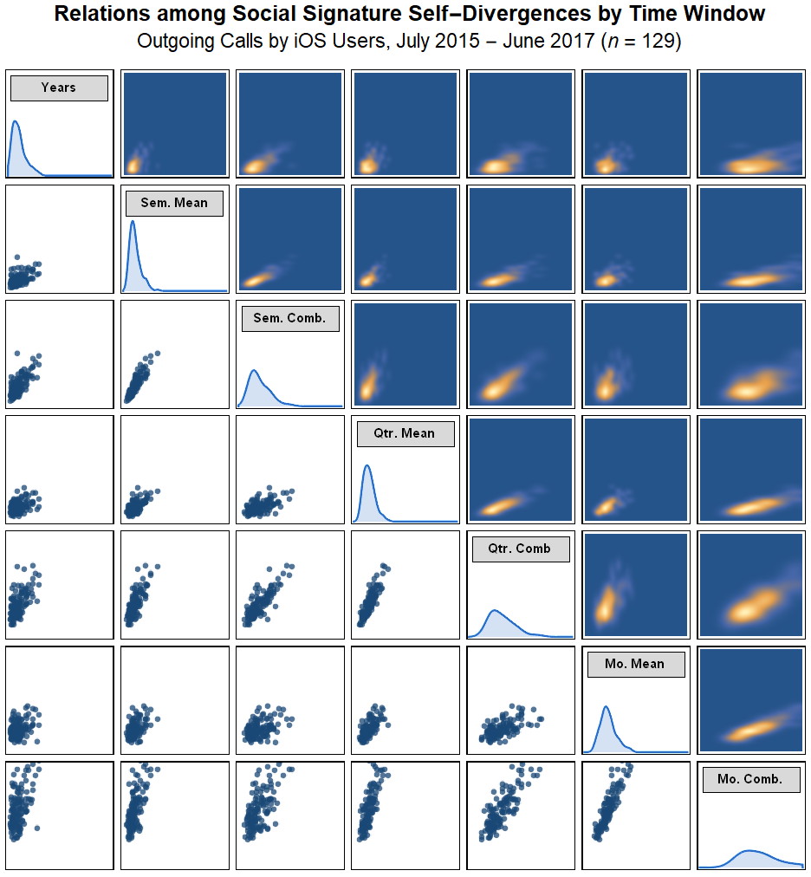
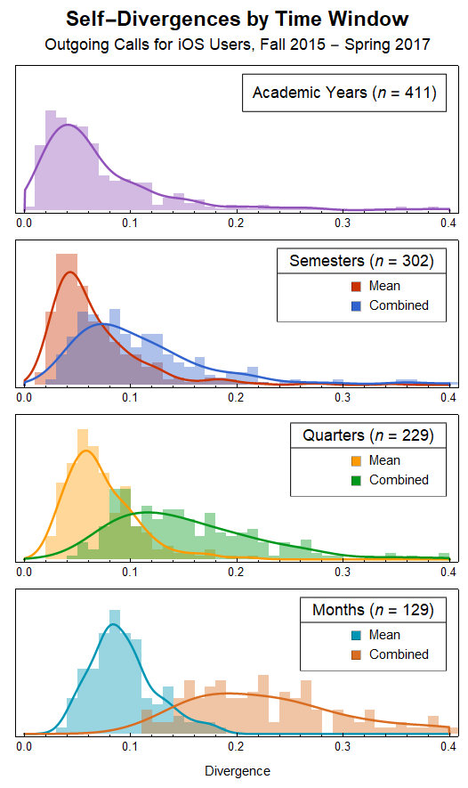
Procedure for Large Bins
Group outgoing call records by ego, and then by time window (based on calendar dates)
For each ego and window, tally the number of calls to each alter
For a given window width, select those egos with more than 1 alter in every window and an average number of calls per window greater than 10
When comparing window widths, select those egos satisfying the above criteria for all window widths

Slide 14
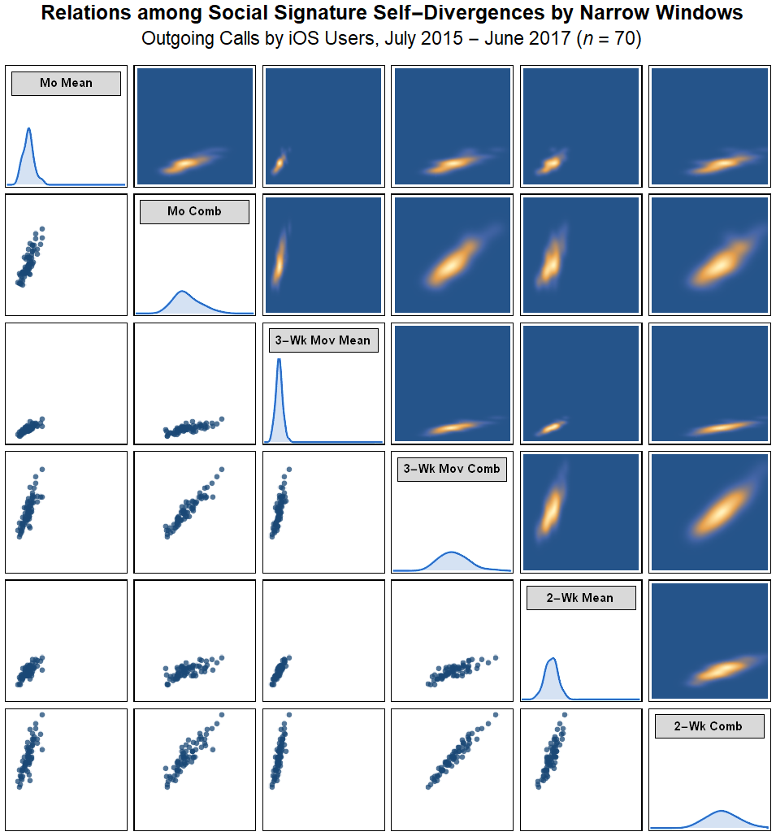
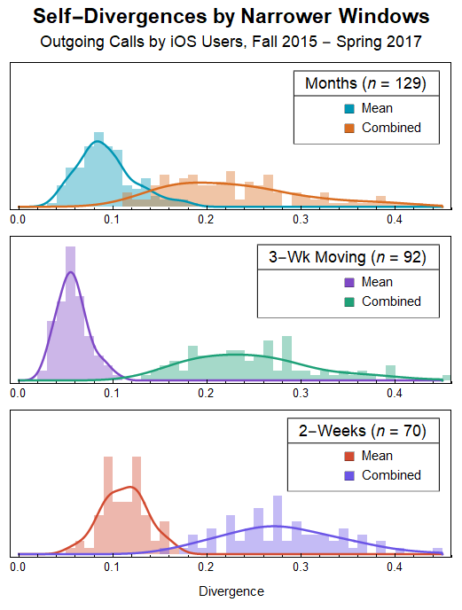

Slide 15
Reference Divergence
All pairs, averaged over time windows
Starts with all ego-ego pairs by window
Divergence between the social signatures of ego A and ego B within window C
With n egos and w windows, we compute Binomial[n,2]*w divergence values
For each pair, average divergence over all time windows
So we end up with Binomial[n,2] values
Used to compare the central tendencies of self and reference divergence overall
By ego, averaged within time windows
Also starts with all ego-ego pairs by window
For each ego, average divergence over all pairs including ego within each window
With n egos, for a given ego A, select the (n-1) pairs that include A, at all times
For each ego, compute pairwise divergence within each window, giving n*(n-1)*w values
Average over ego within windows
Perhaps also averaged across windows to get n values
Used to assess coviariates of self and reference divergence (e.g., turnover)

Slide 16
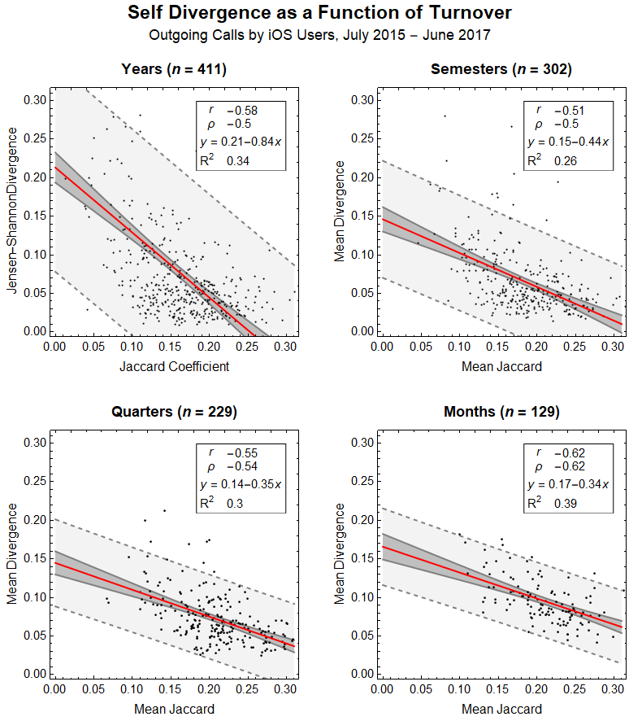
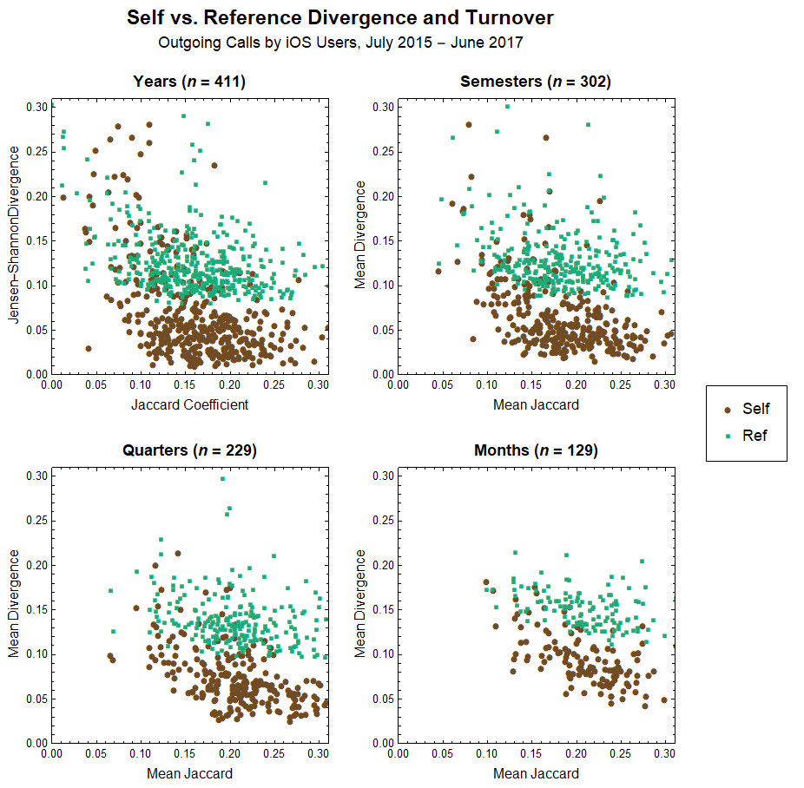

Slide 17
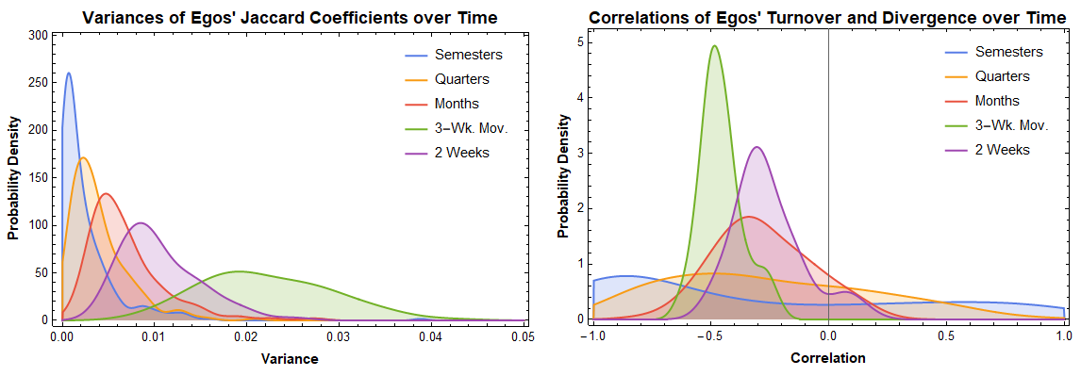

Slide 18
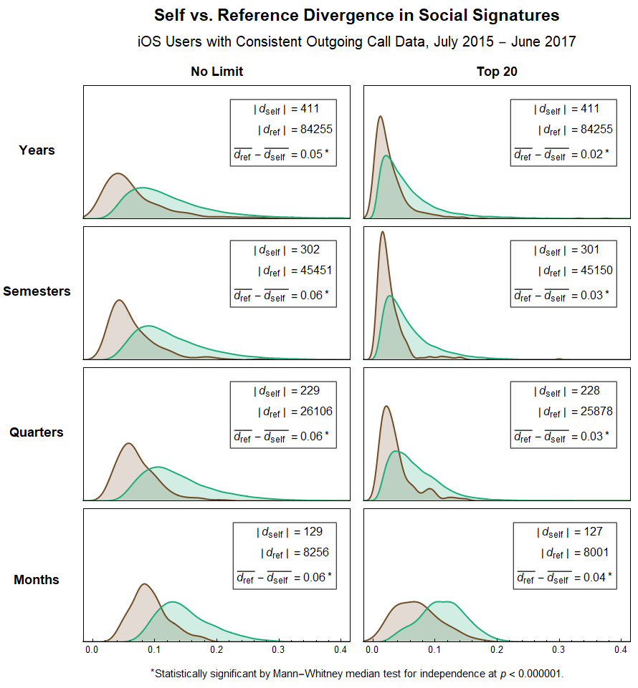
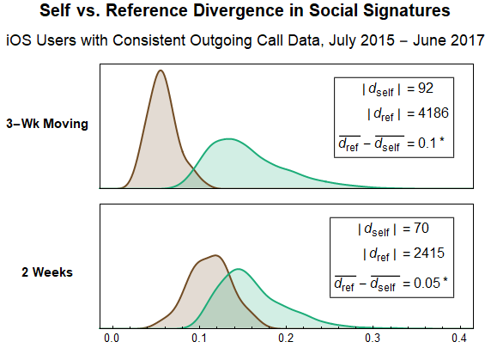


Slide 19
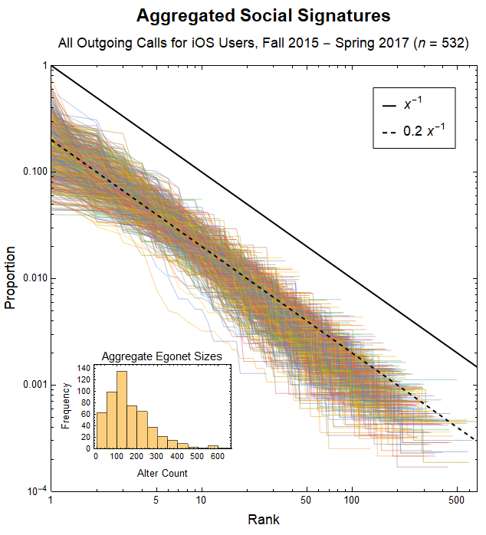
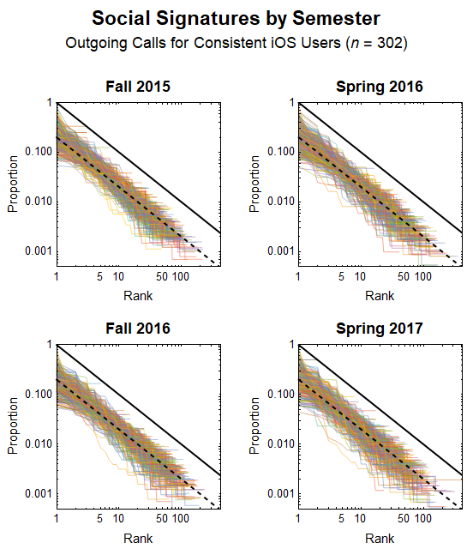

Slide 20
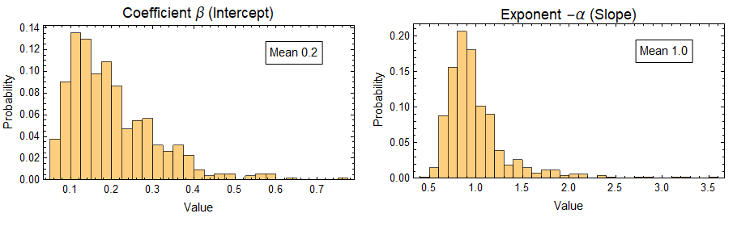

Power-law Models of Aggregated Social Signatures
Both parameters are statistically significant at p<0.00001 for all 532 models.

Slide 21
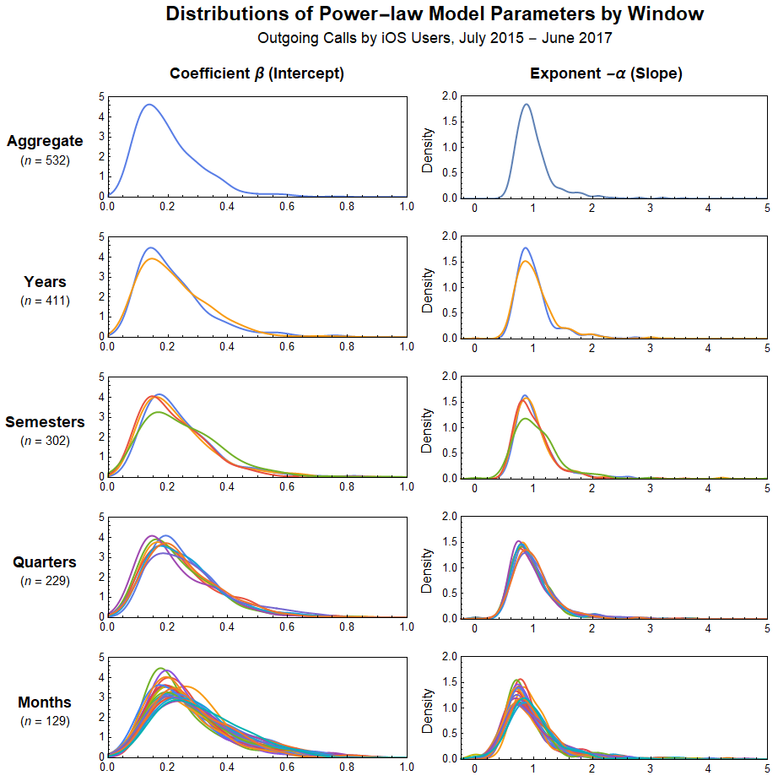

Slide 22
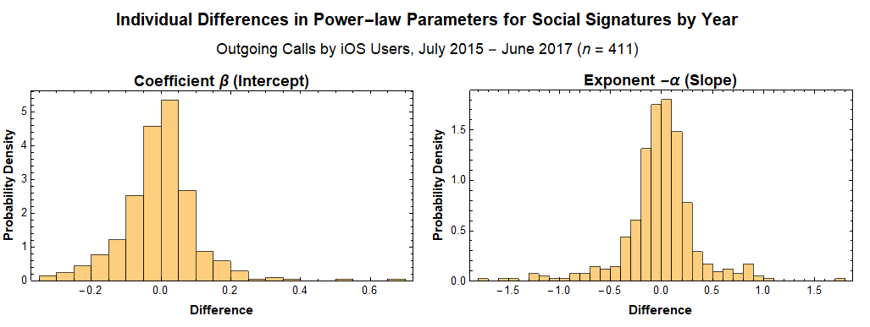
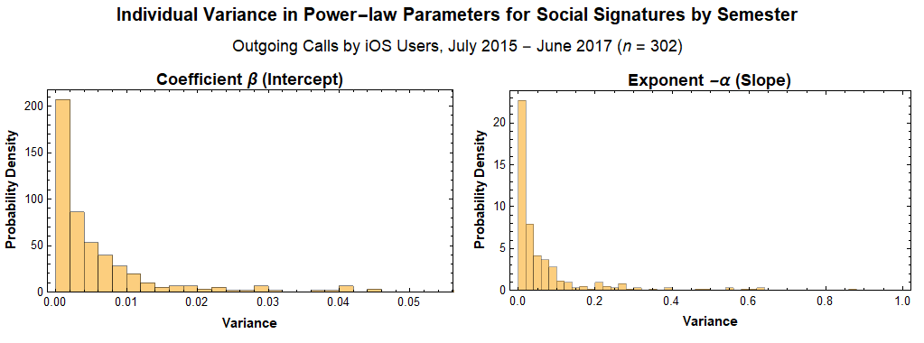

Slide 23
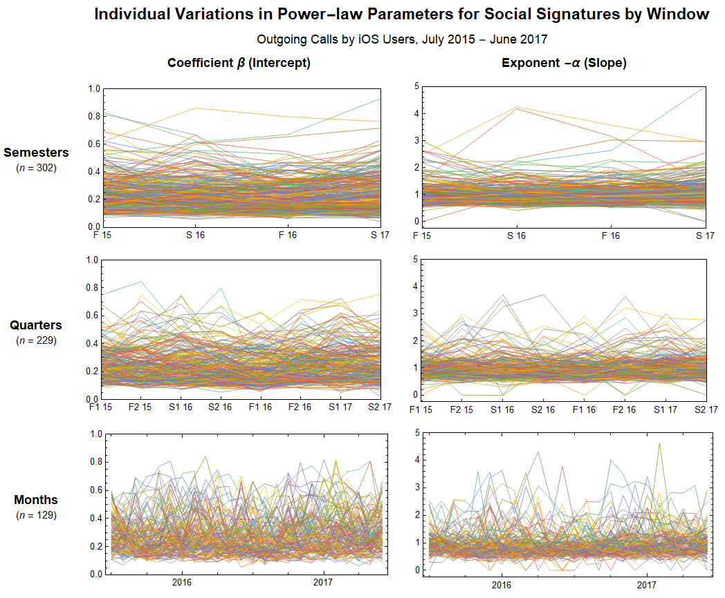

Slide 24

Power-law vs. Exponential Models

Slide 25
Ego variation in parameters; burn-in

Slide 26
Covariants
Degree
Clustering
Turnover
Total activity
Structural typology
Modularity
Betweenness centralization
Density
Diameter
Closeness
Divergence as a function of change in activity level
Tease out turnover and divergence:
How stable when there is more turnover?

